Slide 1

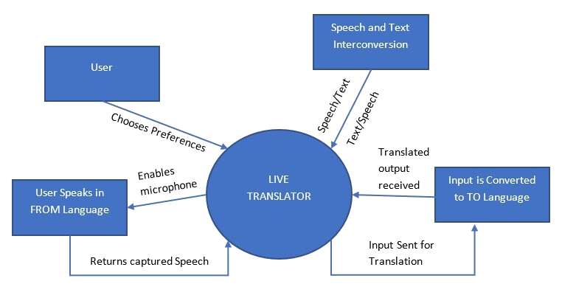
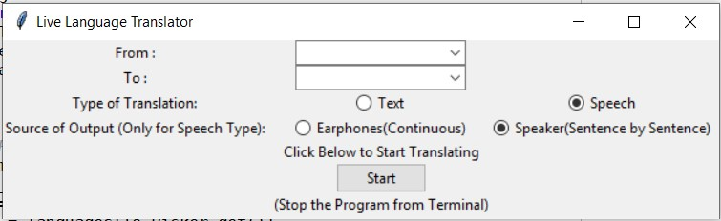
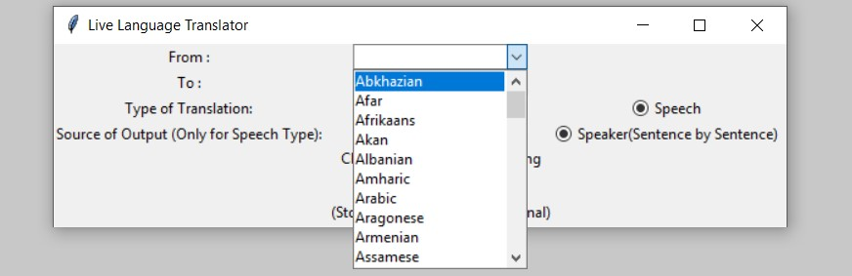
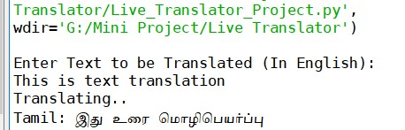
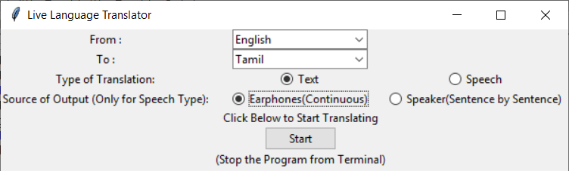
LIVE TRANSLATOR
Abstract
Functionality
Graphical User Interface (GUI)
This tool helps in live translation from within 220 available languages to the other simultaneously as you speak.
Live translation helps us to understand the message appropriately and clearly without having it to type somewhere.
The other person will not know that we don’t know their language because we can understand what ever they speak using this tool.
Portable and not visible to anyone. Helps to reduce the culture shocks and get settled in an environment quickly.
Introduction
Language is one of the basic means of communication to convey feelings with one another.
There are multiple languages in different regions of the world through which people communicate.
Though the meaning of the sentence spoken is same in every language, the way it is put forth is different.
Natural language processing is a segment of artificial intelligence which analyzes the input text to form a meaningful sentence. When the language code of input is given, the input is analyzed according to words and grammar of that particular language.
Once the meaning of the sentence is analyzed, it can be translated to any language by providing the language code. The translation is done completely based on meaning.
Even the numbers, quantities and all such factors are considered while translating to chosen language The conversion is received in the form of text.
It can be converted to speech using other libraries. In this project, the output is in the form of speech because the goal is to make speech to speech translation.
Output generated is also matched according to the pronunciation and slang of that particular language
Modules
Selecting FROM and TO languages from available 220 languages.
Converting speech to text.
Translating from given language to desired language.
Converting text to speech and saving to the system.
Printing the converted speech
Playing the saved output.
Conclusion
Cultural Shocks and Language Barriers were basis behind idea for this project.
Many people face the inconvenience of communication when they are interacting to new people in different regions.
This project can help in translation of languages FROM and TO source and destination languages respectively based on the language preference given by user.
User is given the flexibility of choosing whether the output is through speaker or earphone or text, input is in the form of text or speech as per convenience through GUI.
Based on the preferences chosen by user, enhancements are dynamically committed when the application is executed.
I conclude, this project is efficient for doing live translation based on user needs constantly during a conversation, thus achieving its goal and objective
Add your information, graphs and images to this section.

